Slide 1

Introduction to Scala
Lecture 1
CMSC 331
SD Vick

Slide 2
What’s Scala and why should You Care?
It’s language written by by Martin Odersky at EPFL (École Polytechnique Fédérale de Lausanne (EPFL), Lausanne, Switzerland
Influenced by ML/Haskell, Java and other languages
with better support for component software
It’s a scalable Programming language for component software with a focus is on abstraction, composition, and decomposition and not on primitives
It unifies OOP and functional programming
It interoperates with Java and .NET

Slide 3
Why Scala?
(Coming from Java/C++)
Runs on the JVM
  Can use any Java code in Scala
  Almost as fast as Java (within 10%)
Much shorter code
  Odersky reports 50% reduction in most code over Java
  Local type inference
Fewer errors
  No Null Pointer problems
More flexibility
  As many public classes per source file as you want
  Operator overloading

Slide 4
Getting Started in Scala
scala
  Runs compiled scala code
  Or without arguments, as an interpreter!
scalac - compiles
fsc - compiles faster! (uses a background server to minimize startup time)
Go to scala-lang.org for downloads/documentation
Read Scala: A Scalable Language
(see http://www.artima.com/scalazine/articles/scalable-language.html )

Slide 5
Features of Scala
Scala is both functional and object-oriented
  every value is an object
  every function is a value--including methods
Scala is statically typed
  includes a local type inference system:
  in Java 1.5:
  Pair<Integer, String> p =
  new Pair<Integer, String>(1, "Scala");
  in Scala:
  val p = new MyPair(1, "scala");

Slide 6
Scala – The Interpreter
Easiest way to get started with Scala is by using the Scala interpreter, which is an interactive “shell” for writing Scala expressions
Simply type an expression into the interpreter and it will evaluate the expression and print the resulting value.
$ scala
This is an interpreter for Scala. Type in expressions to have them evaluated. Type :help for more information. scala> After you type an expression, such as 1 + 2, and hit return:
scala> 1 + 2
The interpreter will print:
unnamed0: Int = 3
This line includes: an automatically assigned or user-defined name to refer to the computed value (unnamed0) a colon (:) the type of the expression and its resulting value (Int) an equals sign (=) the value resulting from evaluating the expression (3)

Slide 7
More features
Supports lightweight syntax for anonymous functions, higher-order functions, nested functions, currying
ML-style pattern matching
Integration with XML
  can write XML directly in Scala program
  can convert XML DTD into Scala class definitions
Support for regular expression patterns

Slide 8
Other features
Allows defining new control structures without using macros, and while maintaining static typing
Any function can be used as an infix or postfix operator
Can define methods named +, <= or ::

Slide 9
Automatic Closure Construction
Allows programmers to make their own control structures
Can tag the parameters of methods with the modifier def.
When method is called, the actual def parameters are not evaluated and a no-argument function is passed

Slide 10
While loop example
object TargetTest1 with Application {
def loopWhile(def cond: Boolean)(def body: Unit): Unit =
if (cond) {
body;
loopWhile(cond)(body);
}
var i = 10;
loopWhile (i > 0) {
Console.println(i);
i = i – 1
Note: var/val
}
}
Define loopWhile method
Use it with nice syntax

Slide 11
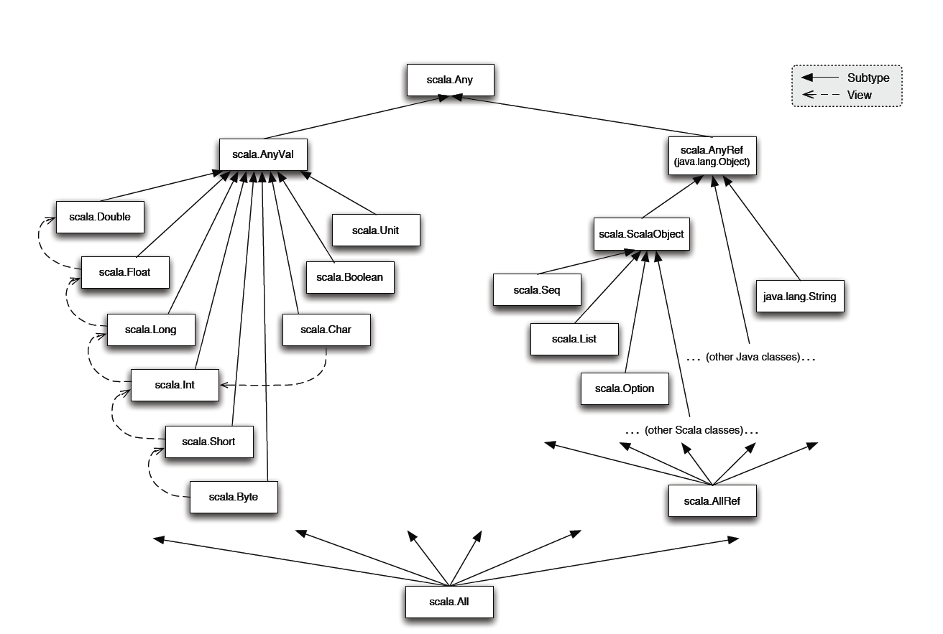
Scala class hierarchy

Slide 12
Scala object system
Class-based
Single inheritance
Can define singleton objects easily (no need for static which is not really OO)
Traits, compound types, and views allow for more flexibility
Notes:
Since traits do not encapsulate state, inheriting twice from a trait is legal in Scala.

Slide 13
Basic Scala
Use var to declare variables:
  var x = 3;
  x += 4;
Use val to declare values (final vars)
  val y = 3;
  y += 4; // error
Notice no types, but it is statically typed
  var x = 3;
  x = “hello world”; // error
Type annotations:
  var x : Int = 3;

Slide 14
Basic Scala
Class instances
  val c = new IntCounter[String];
Accessing members (Look Ma no args!)
  println(c.size); // same as c.size()
Defining functions:
    def foo(x : Int) { println(x == 42); }
    def bar(y : Int): Int = y + 42; // no braces // needed!
    def return42 = 42; // No parameters either!

Slide 15
Functions, Mapping, Filtering
Defining lambdas – nameless functions (types sometimes needed)
  val f = x :Int => x + 42; f is now a mapping int-> int
Closures! A way to haul around state
  var y = 3;
  val g = {x : Int => y += 1; x+y; }
Maps (and a cool way to do some functions)
  List(1,2,3).map(_+10).foreach(println)
Filtering (and ranges!)
    1 to 100 filter (_ % 7 == 3) foreach (println)
  (Feels a bit like doing unix pipes?)

Slide 16
Classes and Objects
  trait Nat;
  object Zero extends Nat {
  def isZero: boolean = true;
  def pred: Nat =
  throw new Error("Zero.pred");
  }
  class Succ(n: Nat) extends Nat {
  def isZero: boolean = false;
  def pred: Nat = n;
  }
Notes:
Traits are similar to interfaces in Java.
Nat defines a trait that’s just a placeholder. Zero has only one instance, so it’s an object rather than a class.

Slide 17
Traits
Similar to interfaces in Java
They may have implementations of methods
But can’t contain state
Can be multiply inherited from

Slide 18
More on Traits
Halfway between an interface and a class, called a trait.
A class can incorporate as multiple Traits like Java interfaces but unlike interfaces they can also contain behavior, like classes.
Also, like both classes and interfaces, traits can introduce new methods.
Unlike either, the definition of that behavior isn't checked until the trait is actually incorporated as part of a class.

Slide 19
Example of traits
trait Similarity {
def isSimilar(x: Any): Boolean;
def isNotSimilar(x: Any): Boolean = !isSimilar(x);
}
class Point(xc: Int, yc: Int) with Similarity {
var x: Int = xc;
var y: Int = yc;
def isSimilar(obj: Any) =
obj.isInstanceOf[Point] &&
obj.asInstanceOf[Point].x == x;
}
Notes:
Traits can have code, unlike Java interfaces, but can’t have any state associated with them.
Scala allows multiple inheritance of traits

Slide 20
Mixin class composition
Basic inheritance model is single inheritance
But mixin classes allow more flexibility
class Point2D(xc: Int, yc: Int) {
val x = xc;
val y = yc;
// methods for manipulating Point2Ds
}
class ColoredPoint2D(u: Int, v: Int, c: String)
extends Point2D(u, v) {
var color = c;
def setColor(newCol: String): Unit = color = newCol;
}

Slide 21
Mixin class composition example
Point2D
ColoredPoint2D
Point3D
ColoredPoint3D
ColoredPoint2D
class Point3D(xc: Int, yc: Int, zc: Int)
extends Point2D(xc, yc) {
val z = zc;
// code for manipulating Point3Ds
}
class ColoredPoint3D(xc: Int, yc: Int, zc: Int, col: String)
extends Point3D(xc, yc, zc)
with ColoredPoint2D(xc, yc, col);

Slide 22
Mixin class composition
Mixin composition adds members explicitly defined in ColoredPoint2D
(members that weren’t inherited)
Mixing a class C into another class D is legal only as long as D’s superclass is a subclass of C’s superclass.
  i.e., D must inherit at least everything that C inherited
Why?

Slide 23
Mixin class composition
Remember that only members explicitly defined in ColoredPoint2D are mixin inherited
So, if those members refer to definitions that were inherited from Point2D, they had better exist in ColoredPoint3D
  They do, since
  ColoredPoint3D extends Point3D
  which extends Point2D

Slide 24
Views
Defines a coercion from one type to another
Similar to conversion operators in C++/C#
  trait Set {
  def include(x: int): Set;
  def contains(x: int): boolean
  }
  def view(list: List) : Set = new Set {
  def include(x: int): Set = x prepend xs;
  def contains(x: int): boolean =
  !isEmpty &&
  (list.head == x || list.tail contains x)
  }

Slide 25
Views
Views are inserted automatically by the Scala compiler
If e is of type T then a view is applied to e if:
  expected type of e is not T (or a supertype)
  a member selected from e is not a member of T
Compiler uses only views in scope
Suppose xs : List and view above is in scope
val s: Set = xs;
xs contains x
val s: Set = view(xs);
view(xs) contains x
Notes:
Note that changes to the result returned by ‘view’ are not reflected in the original function.

Slide 26
Compound types motivation
trait Cloneable {
def clone();
}
trait Resetable {
def reset: Unit;
}
def cloneAndReset(obj: ?): Cloneable = {
val cloned = obj.clone();
obj.reset;
cloned
}

Slide 27
Compound types
In Java, the “solution” is:
  interface CloneableAndResetable extends Cloneable, Resetable
But if the original object did not use the CloneableAndResetable interface, it won’t work
Scala solution: use compound types (also called intersection types)
def cloneAndReset(obj: Cloneable with Resetable): Cloneable = {
...
}

Slide 28
Variance annotations
class Array[a] {
def get(index: int): a
def set(index: int, elem: a): unit;
}
Array[String] is not a subtype of Array[Any]
If it were, we could do this:
val x = new Array[String](1);
val y : Array[Any] = x;
y.set(0, new FooBar());
// just stored a FooBar in a String array!

Slide 29
Variance Annotations
Covariance is ok with functional data structures
trait GenList[+T] {
def isEmpty: boolean;
def head: T;
def tail: GenList[T]
}
object Empty extends GenList[All] {
def isEmpty: boolean = true;
def head: All = throw new Error("Empty.head");
def tail: List[All] = throw new Error("Empty.tail");
}
class Cons[+T](x: T, xs: GenList[T]) extends GenList[T] {
def isEmpty: boolean = false;
def head: T = x;
def tail: GenList[T] = xs
}

Slide 30
Variance Annotations
Can also have contravariant type parameters
  Useful for an object that can only be written to
Scala checks that variance annotations are sound
  covariant positions: immutable field types, method results
  contravariant: method argument types
  Type system ensures that covariant parameters are only used covariant positions
  (similar for contravariant)

Slide 31
Types as members
abstract class AbsCell {
type T;
val init: T;
private var value: T = init;
def get: T = value;
def set(x: T): unit = { value = x }
}
def createCell : AbsCell {
new AbsCell { type T = int; val init = 1 }
}
Clients of createCell cannot rely on the fact that T is int, since this information is hidden from them

Slide 32
Resources
The Scala programming language home page (see http://www.scala-lang.org/ )
The Scala mailing list (see http://listes.epfl.ch/cgi-bin/doc_en?liste=scala )
The Scala wiki (see http://scala.sygneca.com/ )
A Scala plug-in for Eclipse (see http://www.scala-lang.org/downloads/eclipse/index.html )
A Scala plug-in for IntelliJ (see http://plugins.intellij.net/plugin/?id=1347 )

Slide 33
References
The Scala Programming Language as presented by Donna Malayeri (see http://www.cs.cmu.edu/~aldrich/courses/819/slides/scala.ppt )
The Scala Language Specification 2.7
(seehttp://www.scala-lang.org/docu/files/ScalaReference.pdf )
The busy Java developer's guide to Scala: Of traits and behaviorsUsing Scala's version of Java interfaces(see http://www.ibm.com/developerworks/java/library/j-scala04298.html )
First Steps to Scala (in Scalazine) by Bill Venners, Martin Odersky, and Lex Spoon, May 9, 2007 (see http://www.artima.com/scalazine/articles/steps.html )

